Slide 1
Requested Sequencing Services

Slide 2
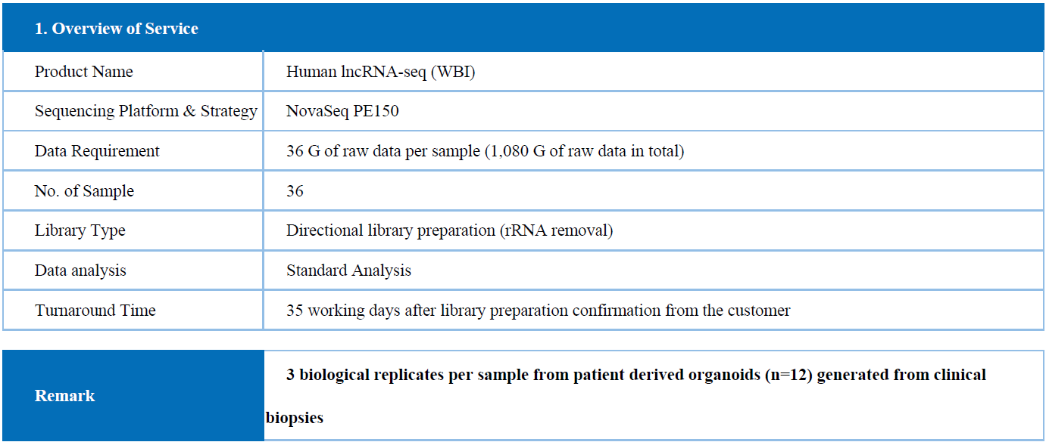
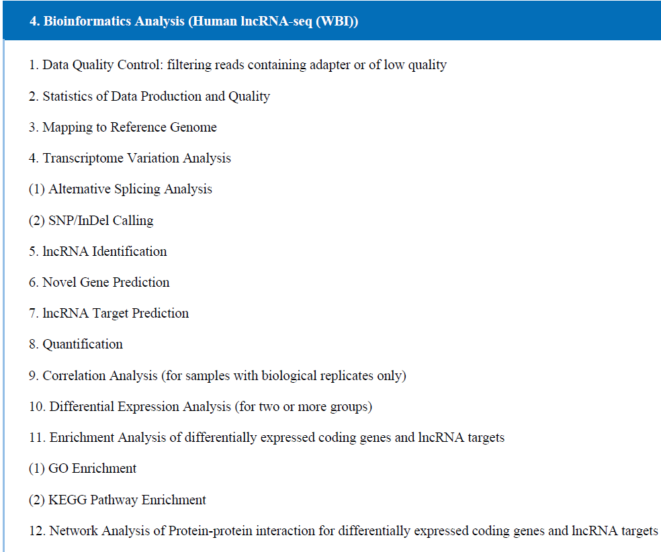
Novogene: RNA sequencing (both lncRNA & mRNA)
Ribo-depletion library preparation: Obtain both lncRNA & mRNA transcriptions, require a minimum of 500 ng of total RNA in 20 ul of ddH20 hence min. concentration of 25 ng/Ul.

Slide 3
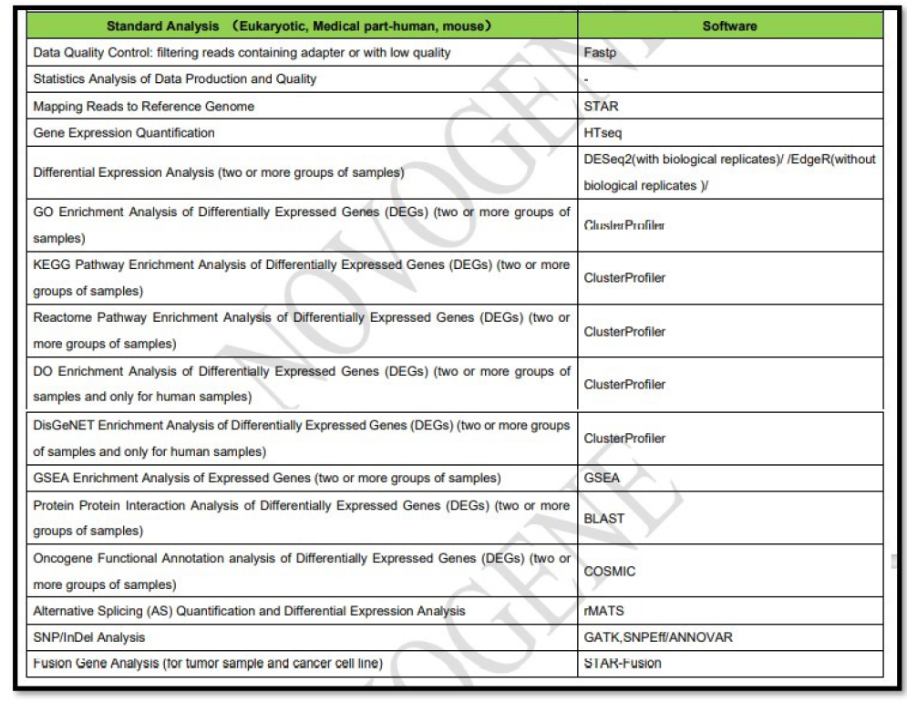
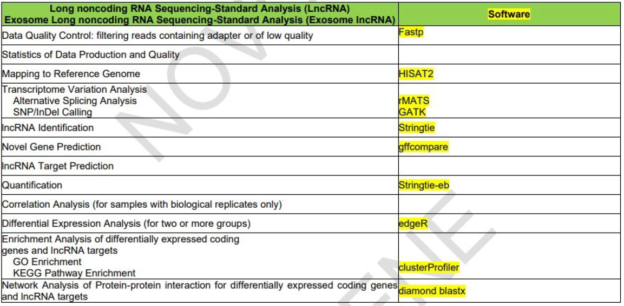
Novogene: RNA sequencing (both lncRNA & mRNA)

Slide 4
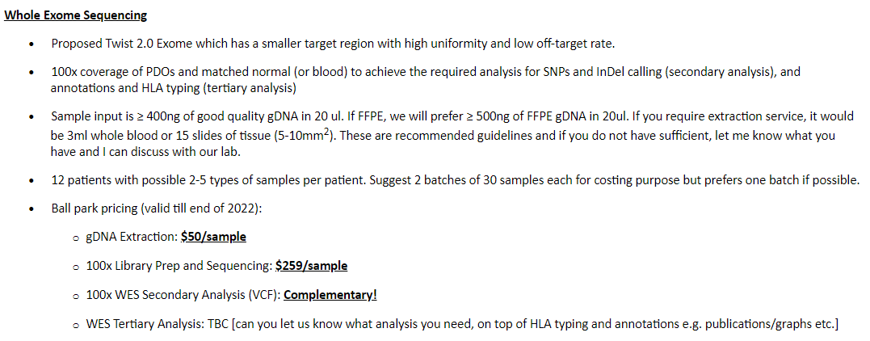
Mirxes: WES

Slide 5
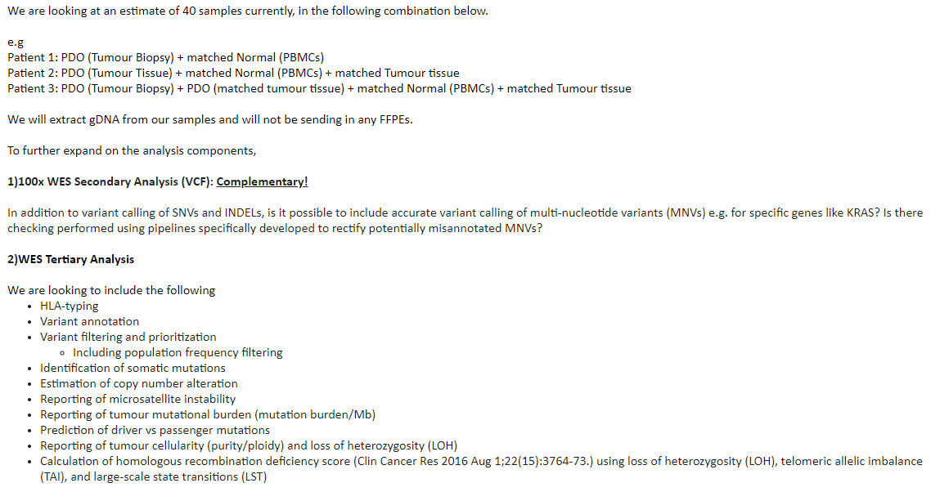
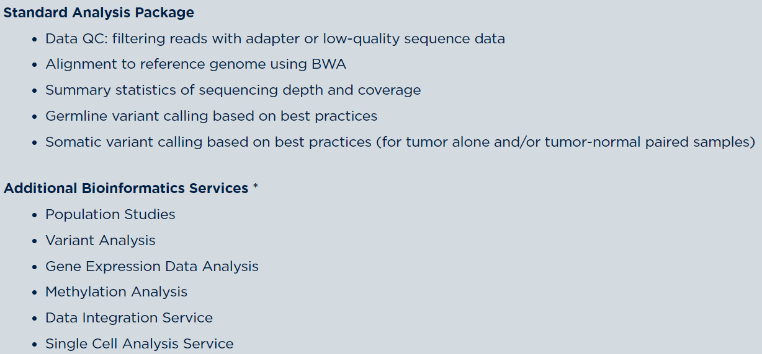
Mirxes: WES

Slide 7
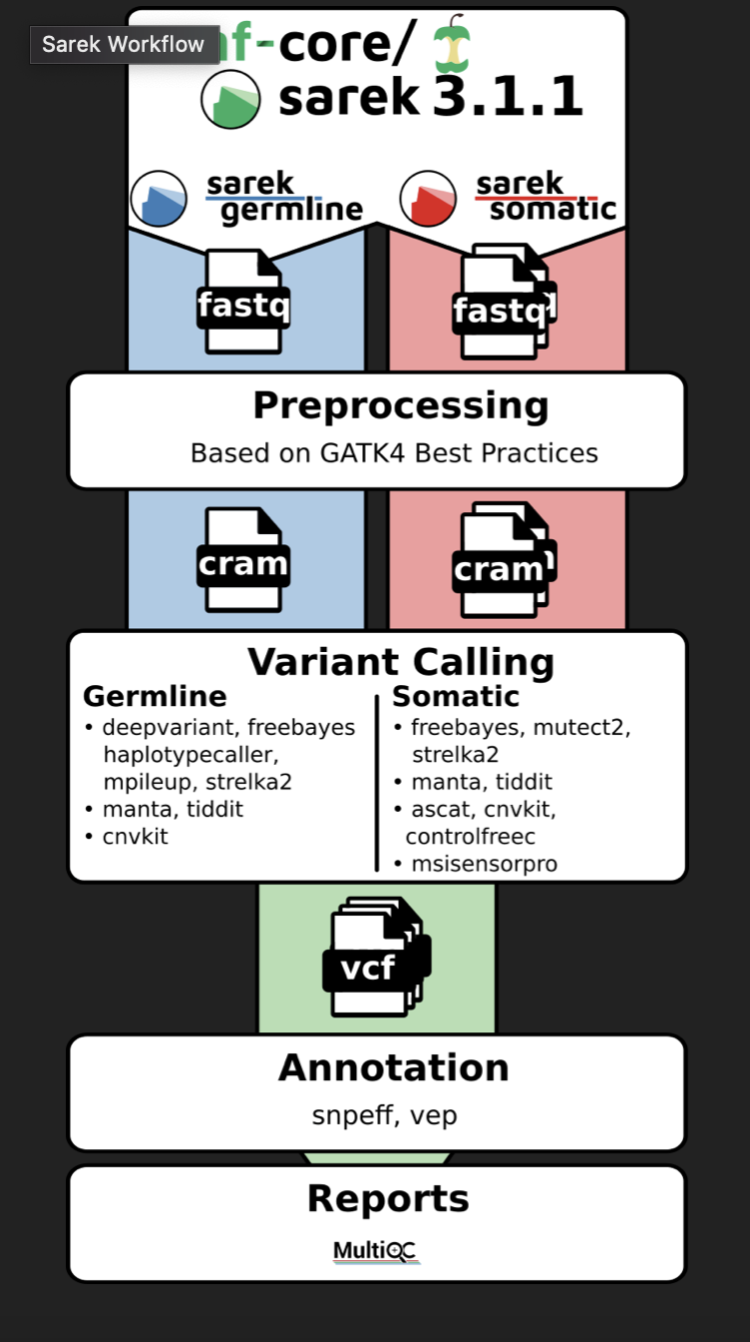
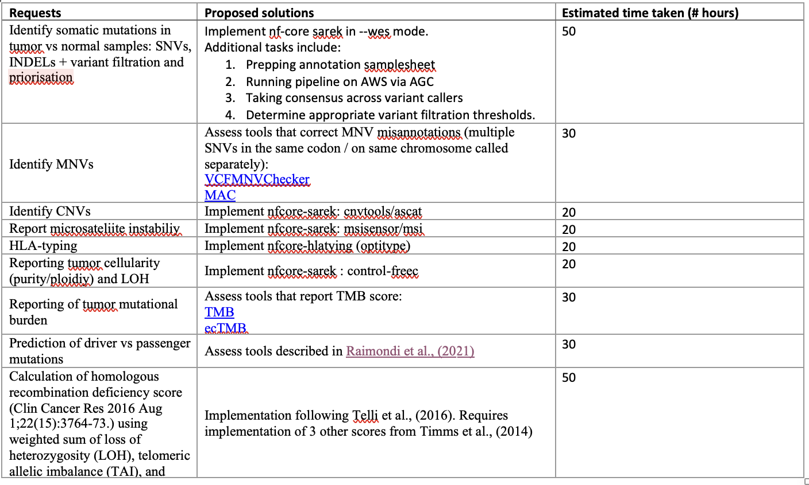
Summary: WES data of 40 samples (PDO/tumor/pbmc) across 6 patients.
Aim: Identify and compare somatic mutations between PDO/tumor samples vs normal tissue. Assess similarity in PDO vs tumor samples.
Start-date: 26 April (data-handover)
Next-steps: Meeting with Claire (phd student) on Monday for detailed discussion of bioinformatic analysis and experimental questions.
Estimated time to completion: 3 months

Slide 8
Main project aims
1. Variation in profile between patient tissue samples
2. Variation in culture media (CM+/-, T1, T2)
3. Extent to which PDOs recapitulate tumor tissue profiles
Condition name | Content
CM | Complete media: both tumor and normal organoids can grow
CM- | Complete media without PGE2- only tumor organoids can grow
T1 | -EGF: KRAS mutant only
T2 | -Wnt -A83-01 Wnt-independent organoids: those that can produce own wnt?

Slide 9
Next steps
Waiting to submit 2nd batch for analysis.
Depends on results of 1st analysis to reprioritize / focus on different samples.
Keen to generate their own protein-biomarkers for chemosensitivty prediction (platinum sensitivity). Want to compare this with HRD mutational signature profile as it is a proxy for chemosensitivity.

